Slide 1


Azuresky (Pty) Ltd
Company profile by: Nonhlanhla Msibi
18/08/2025

Slide 2
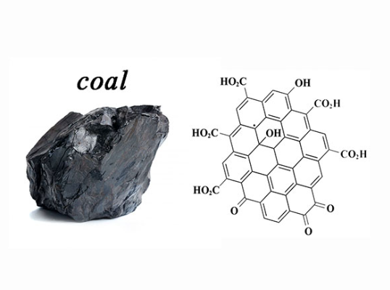
Content:
Background: Company Facts
Client list
Organogram
Value proposition proficiency testing scheme
Value proposition reference material producer
.

Slide 3



Background: company facts
Background on Director and business profile
Core Service
Azuresky (Pty) Ltd is a CIPC registered company with number 2024/223777/07
B-BBEE is valid with a 100% Black Ownership
Shareholding: 100% Female owned (First black female owned) and founded in April 2024 by Nonhlanhla Msibi (CEO)
Tax Clearance is valid
It operates in Gauteng, company address/location is as follows:
17 Makriel Road
Wadeville
GERMISTON
1428
Proficiency Testing Scheme provider for coal analytical laboratories and certified reference material producer/manufacturer of coal testing methods.
It is not SANAS accredited currently since it started operating in May 2025 and planned to fulfil this requirement Dec 2025.
However it operates as per guidelines of:
  - ISO/IEC 17025 general requirements for the competence of testing and calibration laboratories.
  - ISO/IEC 17043 general requirements for the competence of proficiency testing providers
  - ISO/IEC 17034 general requirements for the competence of reference material producers.

Slide 4
Client List
Current clients
Potential Clients
Siza Coal Services – participating with all nine laboratories
Umzamo Analytical Services – participating with all six laboratories
Mfulawamanzi Analytical Services – Participating with two laboratories
Sibonisiwe Analytical Services – Participating with all three laboratories
Ronewa Analytical Services – participating with all three laboratories
Noko Analytical Services – Participating with two laboratories
All Eskom coal laboratories
All Exxaro coal laboratories
All Seriti coal laboratories
All laboratories testing coal in South Africa, Africa and outside of Africa.

Slide 5
Organogram
Managing Director
NP Msibi
ND Analytical Chemistry & BTech Quality
Laboratory Manager
SB Nyambi
Advance Diploma Analytical Chemistry
Laboratory Analysts
x4 - outsourced
Semester 4 Analytical Chemistry
Laboratory Operator
Mpho Serage
(Grade 12 required)
Outsourced functions
HR & Bookkeeping
Laboratory Supervisor
Tshepo M Maponya
Diploma Analytical Chemistry

Slide 6
Value proposition
Proficiency Testing scheme
ISO/IEC 17025:2017 clause 7.7.2 states that laboratories shall monitor its performance by comparison with results of other laboratories. The monitoring shall be planned and reviewed and shall include, but not limited to either or both
- participation in proficiency testing,
-participating in interlaboratory comparisons other than proficiency testing
SANAS R 80-06 clause 4.2 further states that it should be noted that participating in interlaboratory comparisons other than the proficiency testing should be only be envisaged when PT’s are not available and/or appropriate:
A PT is considered available and appropriate if it is:
(ii) Organised by a PT provider accredited to ISO/IEC 17043:2023
(iii) Organised by or participated in accordance with the relevant requirements of ISO/IEC 17043:2023.
It should give you comfort to know that Azuresky (Pty) Ltd satisfies ISO/IEC 17025:2017 clause 7.7.2 and SANAS R80-06 clause 4.2 (iii) requirements. (See attached PT report to enable the assessment thereof)
It should give you comfort to know that participation in Azuresky PT scheme provides the participant with external /independent evaluation of their testing/calibration capabilities.

Slide 7
Value proposition
Reference Material Producer
ISO/IEC 17034:2017 states the general requirements of reference material production. These are used in the daily quality control measurement during the testing of coal, method validation, training of personnel, etc
The key aspects to satisfy:
- Metrological traceability, reference material producer (RMP) shall be traceable which enhances credibility and trustworthiness.
- Value assignment, RMP shall assess the value of their products and application which is crucial for effective communication with coal laboratories.
It should give you comfort to know that Azuresky (Pty) Ltd satisfies ISO/IEC 17034:2017 requirements
Characterization of the material is based on documented information to confirm the origin of material and supported by evidence to identify the material. These include e.g.
Homogeneity checks (presented on certificate)
Stability checks (presented on certificate)
Uncertainty of measurement results( presented on certificate)
The source of material as well as the storage requirements (presented on the certificate)
NB: The certified reference material catalogue is attached along with this presentation. CRM is available for purchase at a price of R382 excluding VAT (VAT is not charged as the company is not registered).

Slide 8
Thank You!

